Slide 1

TALK FOR THE NATION
🎤 -voice for voiceless

Slide 2
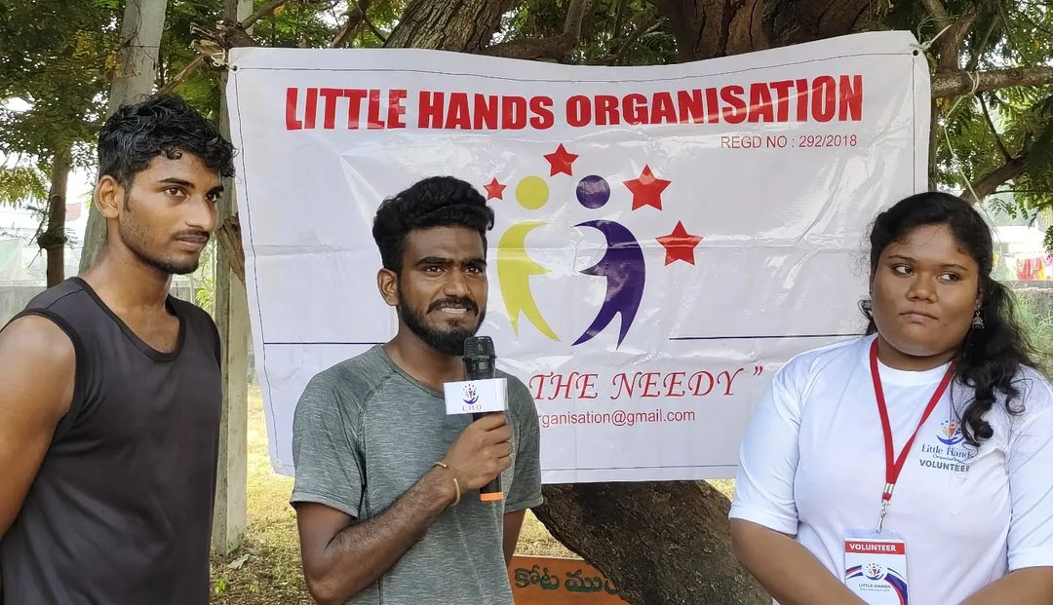
EVENT DETAILS :
AGENDA:
Every citizen wants to do something for their nation. We should know that we can not change our country in just one day or can edracate the wrong things alone . It needs a coordinated efforts of all the citizens of country.
The event “TALK FOR THE NATION” is one such event.

Slide 3
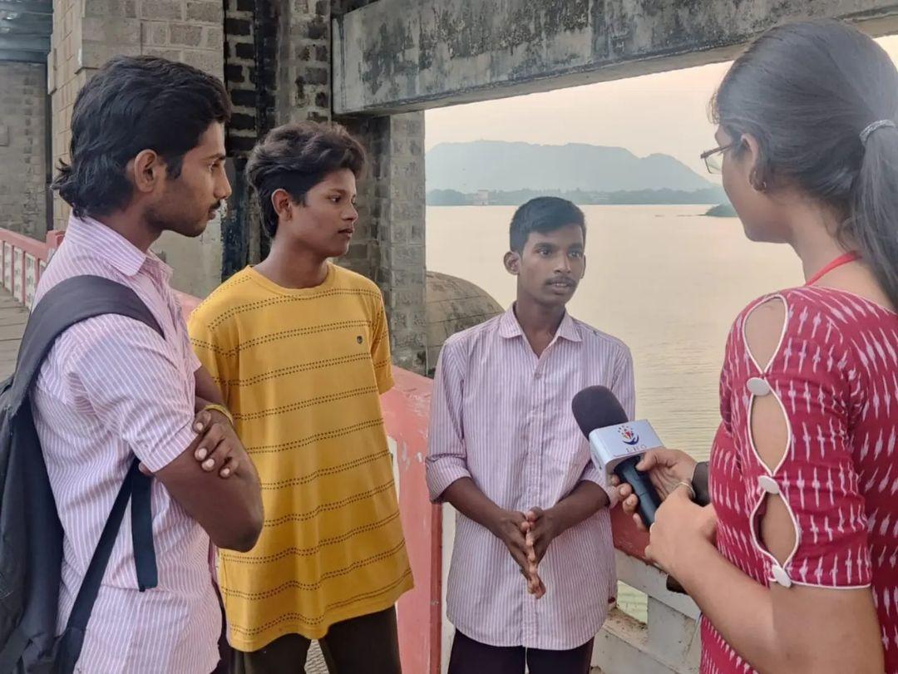
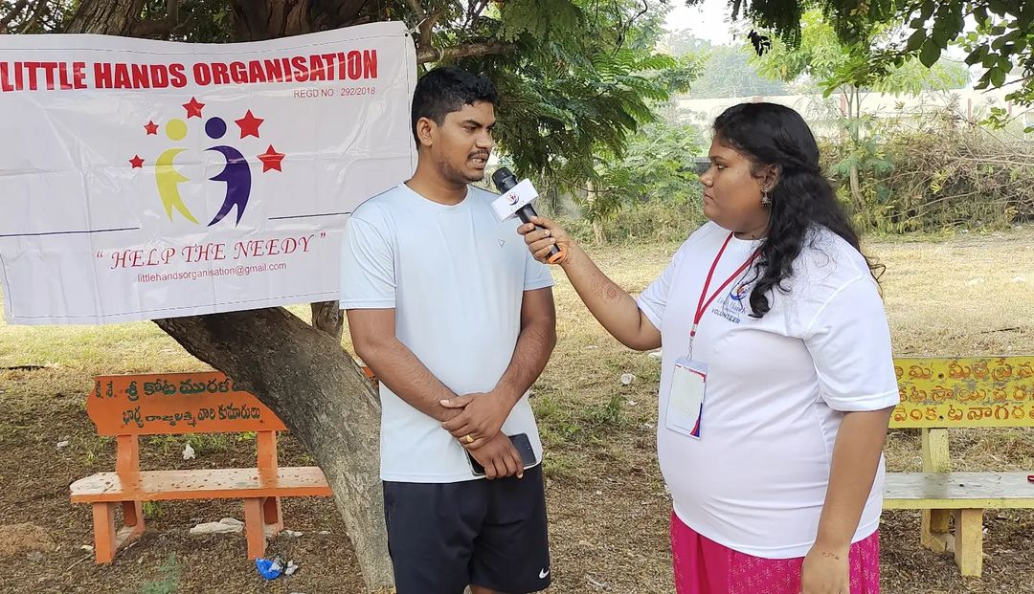
2 . ABOUT:
LHO conducted this event to interact with students and créate the basic awareness about the volunteerisim culture and the need to stand for the nation so that they can put a step forth to be a part of us.

Slide 4
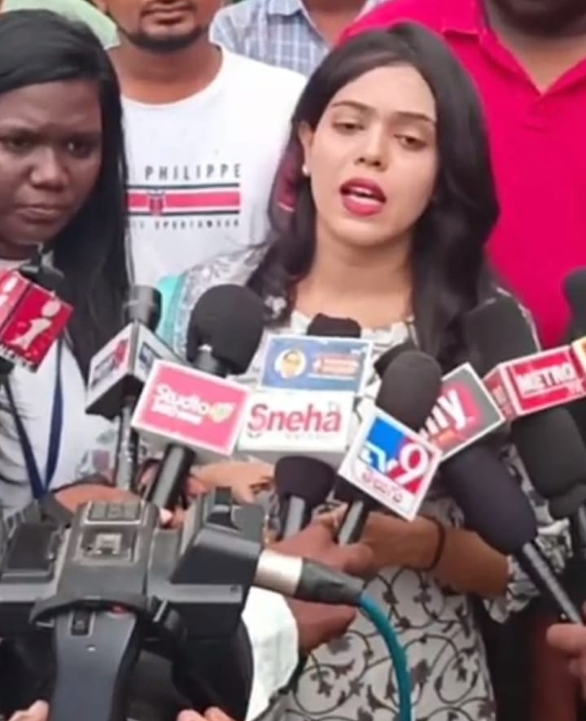
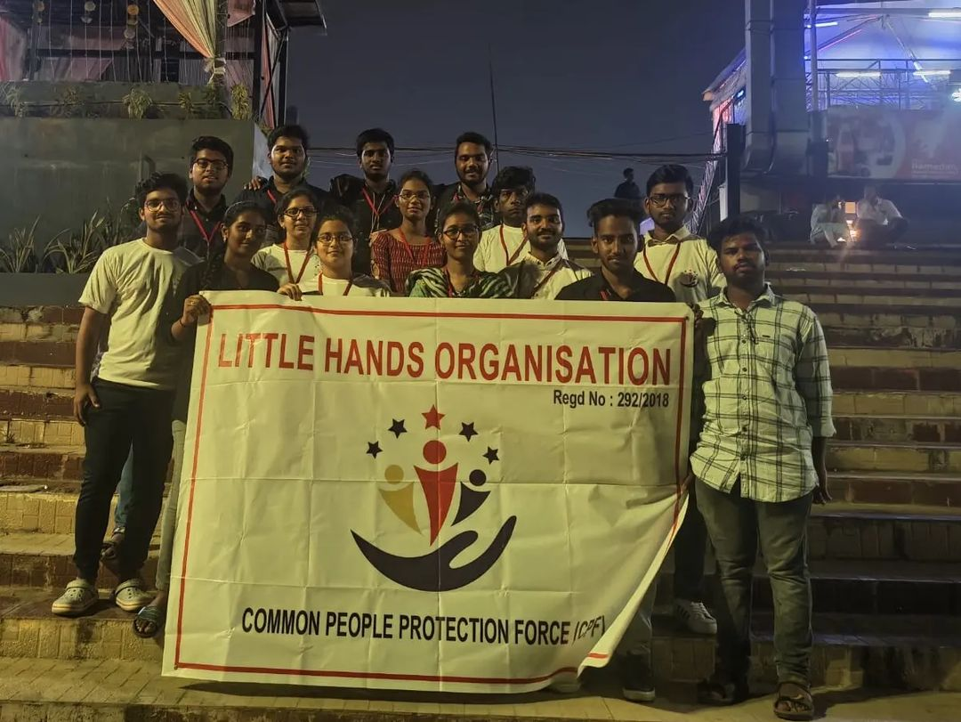
There are some small but awesome things which you can do for your country .it will make you proud that through small things ,you are doing some thing for your nation where you belong to.

Slide 5
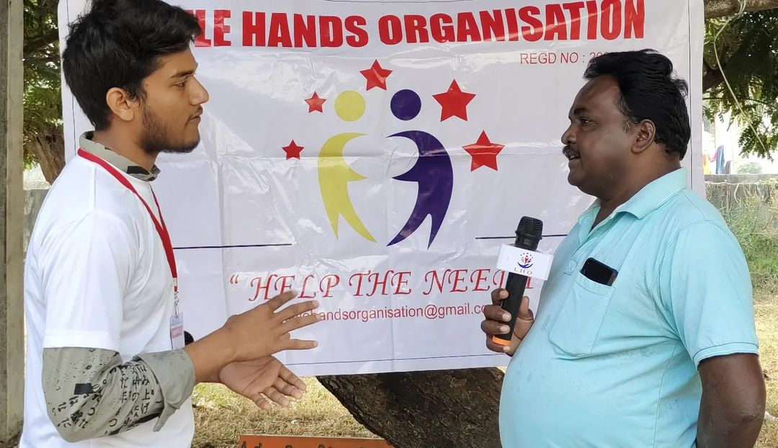
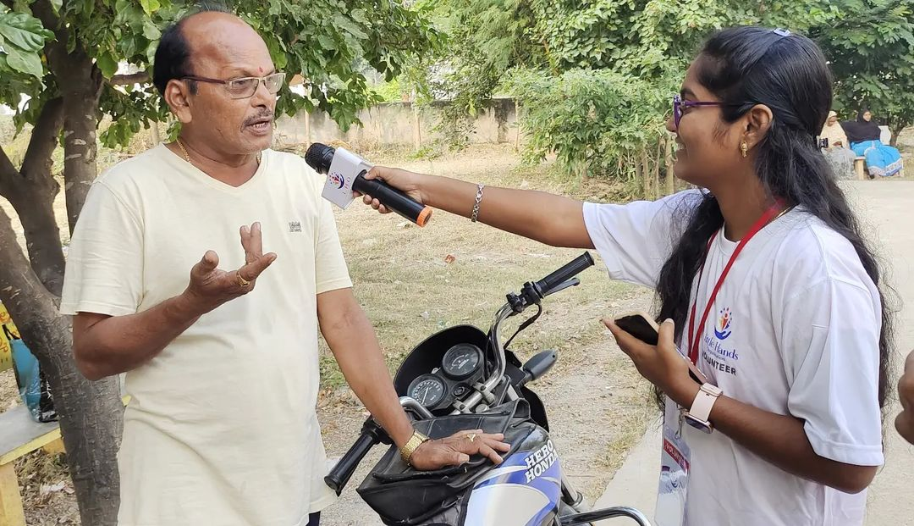
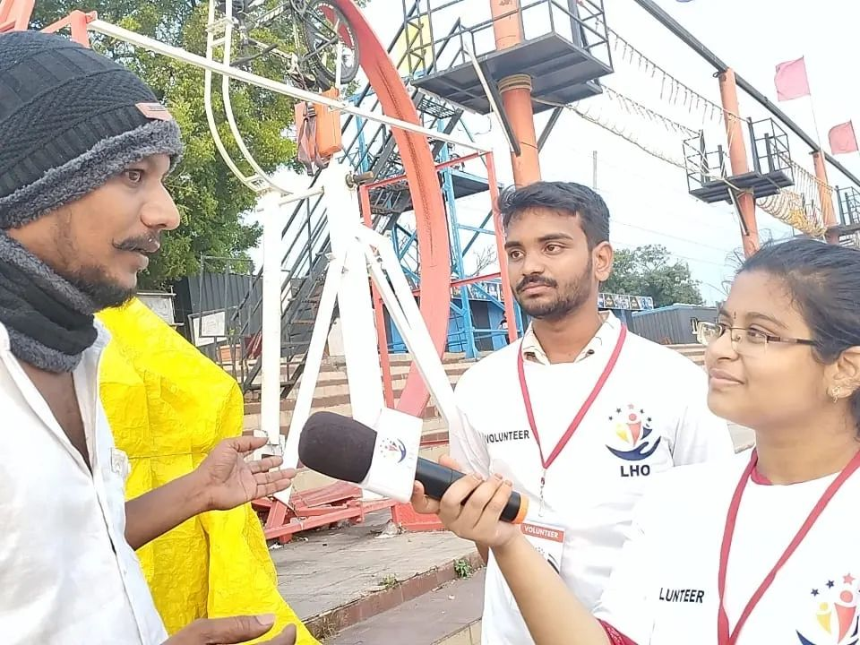
Voice for for voice less

Slide 6
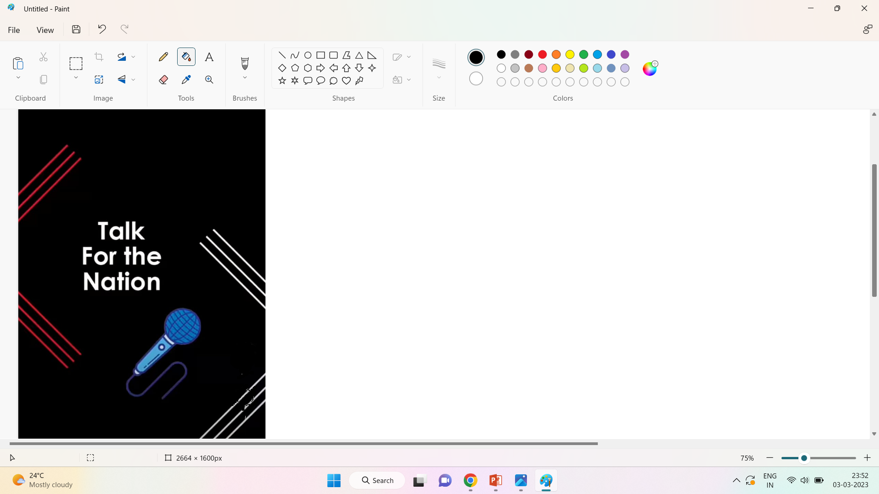
Be the change you want to see in the world .
What the change you want to see in your country,you will have to become part of that change.

Slide 7
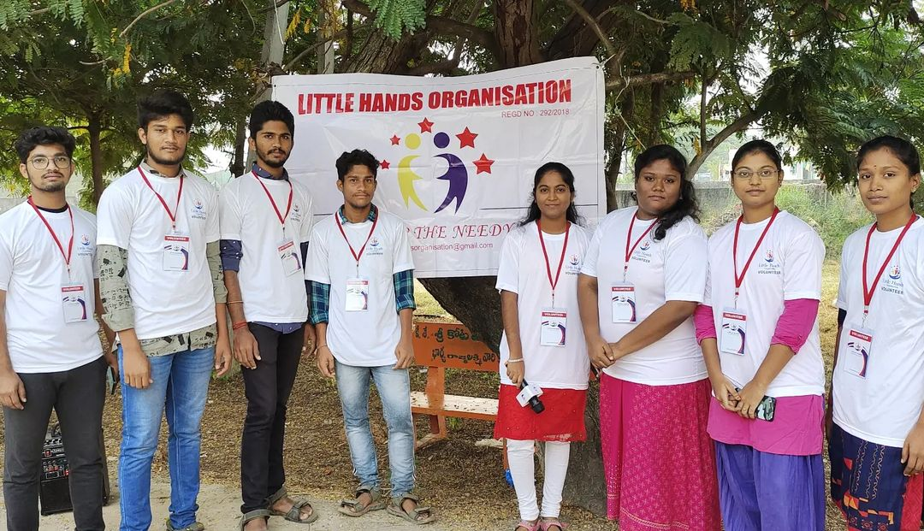
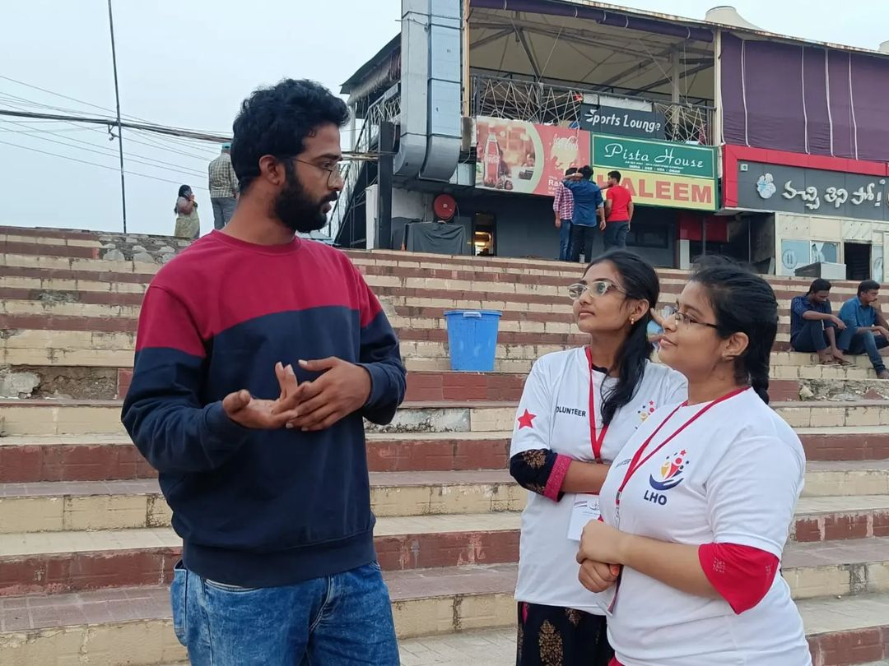
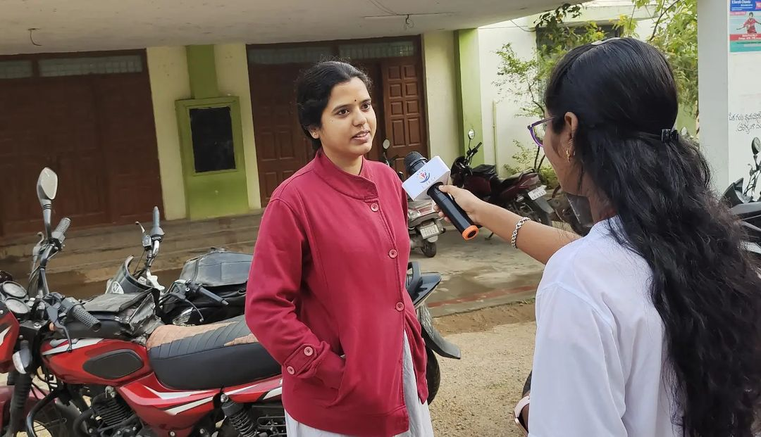

Slide 8
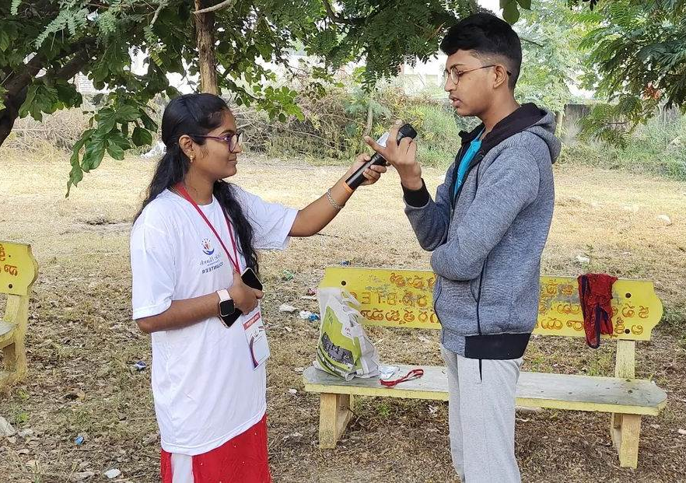
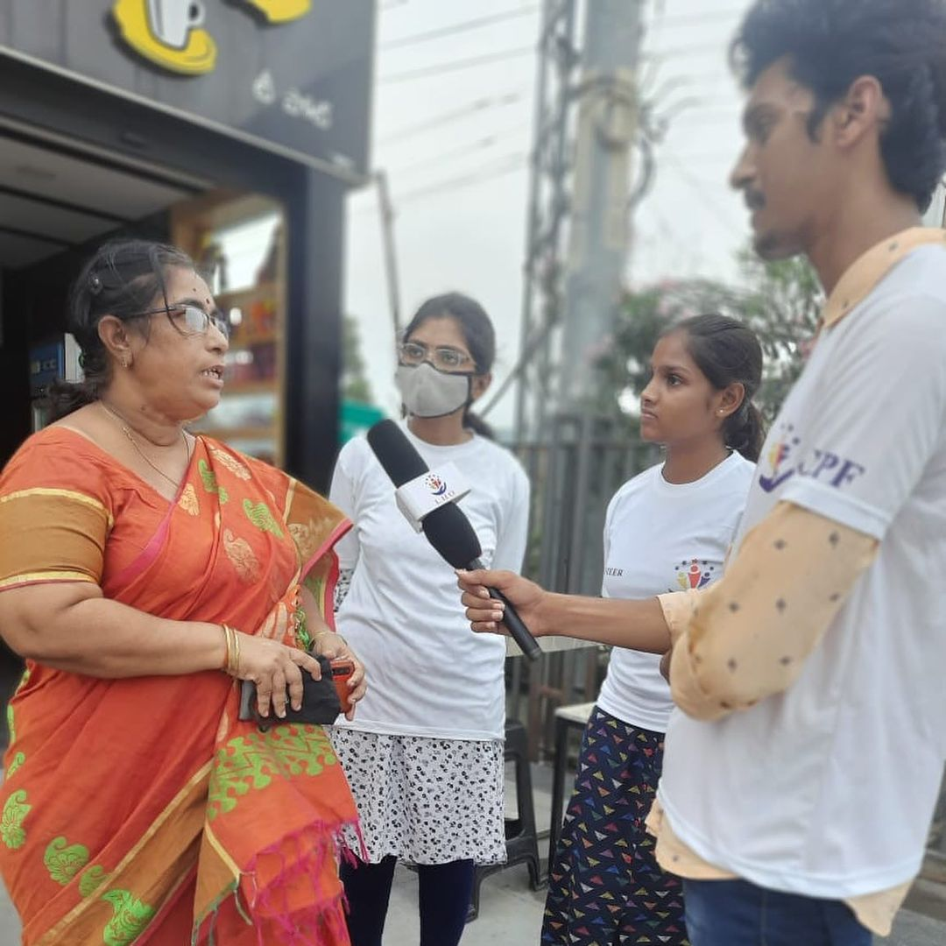
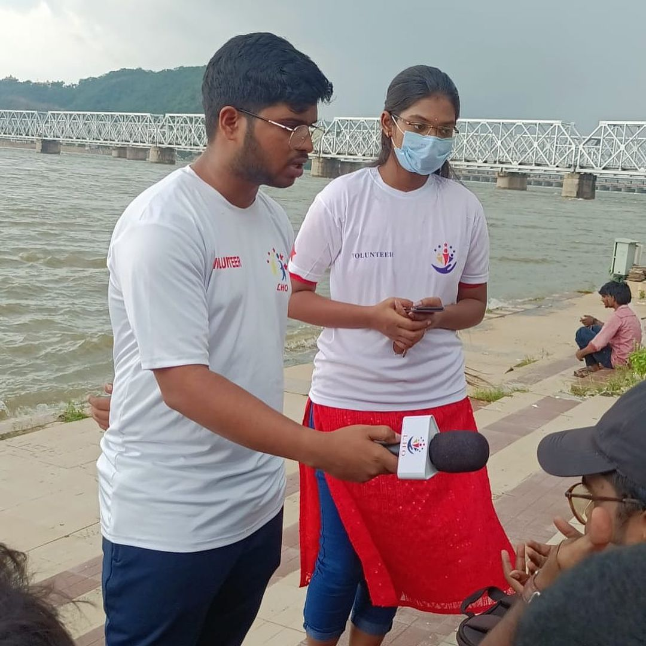
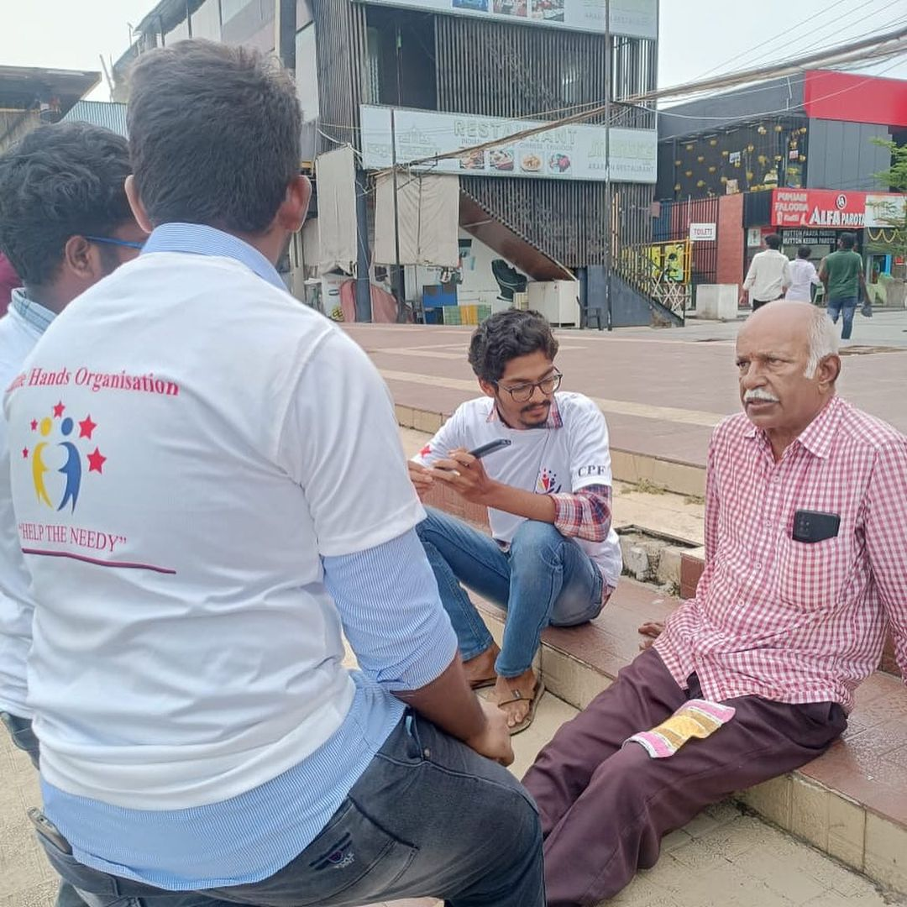
FROM ANGER TO ACTION VOICE !T

Slide 9
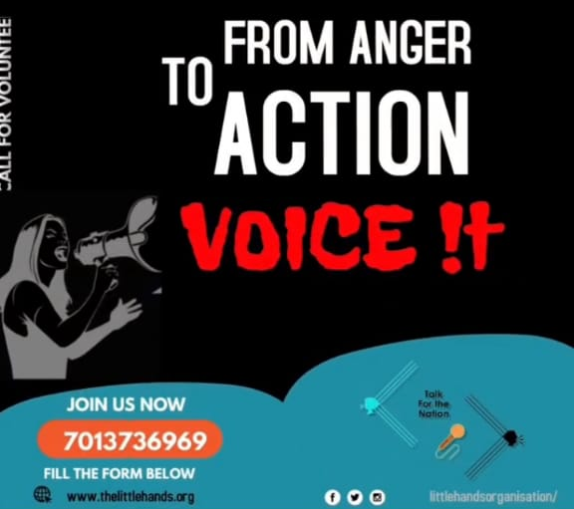

Slide 10
THANK YOU

